Slide 1
Unit – 4 Part I ( Syntax Directed Translation)
BSc CSIT 5th Semester
2020
Mid-Western University, Surkhet
Prepared By:
Dabbal Singh Mahara

Slide 2
Syntax Directed Translation (SDT)
SDT is a compiler implementation where the source language translation is completely driven by the parser.
In other words, the parsing process and parse trees are used to direct semantic analysis and the translation of the source program.
It can be separate phase of a compiler or we can augment our conventional grammar with information to control the semantic analysis and translation. Such grammars are called attribute grammars.
For example, variables may have an attribute "type" (which records the declared type of a variable, useful later in type-checking) or an integer constant may have an attribute "value" (which we will later need to generate code).

Slide 3
Syntax Directed Translation (SDT)
With each production in a grammar, we give semantic rules or actions, which describe how to compute the attribute values associated with each grammar symbol in a production.
So we can say that: Grammar + semantic rule = SDT
The attribute value for a parse node may depend on information from its children nodes below or its siblings and parent node above.
There are two notations for associating semantic rules with productions, which are:
Syntax- directed definitions and
Translation schema

Slide 4
Syntax-Directed Definition (SDD)
Syntax-Directed Definitions are high level specifications for translations.
They hide many implementation details and free the user from having to explicitly specify the order in which translation takes place.
SDD uses two types of attributes: synthesized and inherited attributes
Mathematically, Given a production A → α then each semantic rule is of the form b = f(c1,c2,…,ck)
where f is a function and ci are attributes of A and α, and either b is a synthesized attribute of A or b is an inherited attribute of one of the grammar symbols in α.

Slide 5
SDD Example
The syntax directed definition for a simple desk calculator
Production Semantic Rules
L → E return print(E.val)
E → E1 + T E.val = E1.val + T.val
E → T E.val = T.val
T → T1 * F T.val = T1.val * F.val
T → F T.val = F.val
F → ( E ) F.val = E.val
F → digit F.val = digit.lexval

Slide 6
Inherited and Synthesized Attributes
The attribute of nonterminal that can take value either from its parent or from its siblings is called inherited attribute.
For example, let’s say A -> BC is a production of a grammar and B’s attribute is dependent on A’s attributes or C’s attributes then it will be inherited attribute.
Synthesized attributes are those attributes which can take value only from its children.
Synthesized attributes represent information that is being passed up the parse tree.
For eg. let’s say A -> BC is a production of a grammar, and A’s attribute is dependent on B’s attributes or C’s attributes then it will be synthesized attribute.

Slide 7
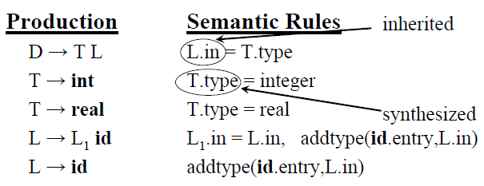
Example: Inherited and Synthesized Attributes

Slide 8
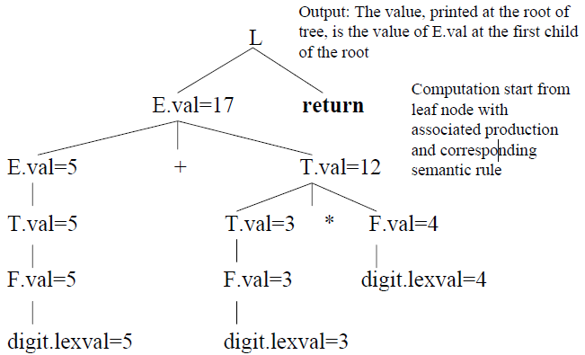
Annotated Parse Tree
A parse tree constructing for a given input string in which each node showing the values of attributes is called an annotated parse tree.
Now the annotated parse tree for the input string 5+3*4 considering grammar in slide 5 is:

Slide 9
Dependency Graph
If interdependencies among the inherited and synthesized attributes in an annotated parse tree are specified by arrows then such a tree is called dependency graph.
In order to correctly evaluate attributes of syntax tree nodes, a dependency graph is useful.
A dependency graph is a directed graph that contains attributes as nodes and dependencies across attributes as edges.

Slide 10
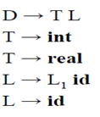
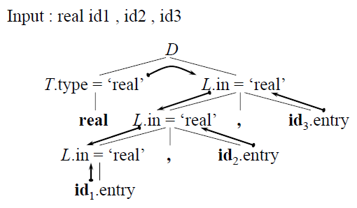
Example: Dependency Graph
Example: let’s take a grammar,

Slide 11
S-Attributed Definitions
A syntax-directed definition that uses synthesized attributes exclusively is called an S-attributed definition (or S-attributed grammar).
A parse tree of an S-attributed definition is annotated by evaluating the semantic rules for the attribute at each node in bottom-up manner.
Let’s take a grammar:
L → E return print(E.val)
E → E1 + T E.val = E1.val + T.val
E → T E.val = T.val
T → T1 * F T.val = T1.val * F.val
T → F T.val = F.val
F → ( E ) F.val = E.val
F → digit F.val = digit.lexval
Input String: 3*5+4 n

Slide 12
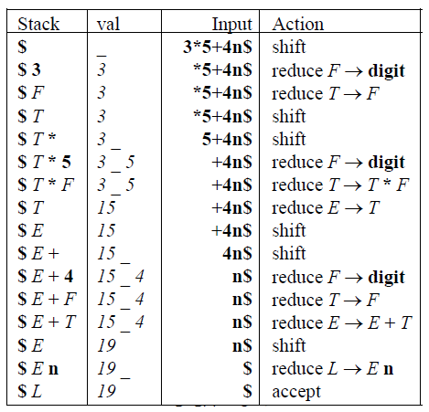
Bottom-up Evaluation of S-Attributed Definitions
Input String: 3*5+4 n

Slide 13
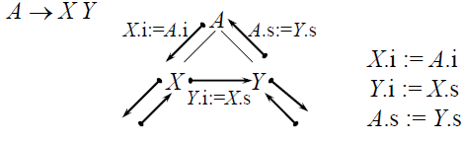
L-Attributed Definitions
If an SDT uses both synthesized attributes and inherited attributes with a restriction that inherited attribute can inherit values from left siblings only, it is called as L-attributed SDT.
Attributes in L-attributed SDTs are evaluated by depth-first and left-to-right parsing manner.
Example:

Slide 14

Translation Scheme
A translation scheme is a context-free grammar in which attributes are associated with the grammar symbols and semantic actions are inserted within the right sides of productions and are enclosed between braces { }.
So a translation scheme is like a syntax-directed definition, except that the order of evaluation of the semantic rules is explicitly shown.
When drawing a parse tree for a translation scheme, an action is indicated by constructing an extra child, connected by a dashed line to the node of the production.
The order in which the actions are executed is the order in which they appear during a depth-first traversal of a parse tree.
Example:

Slide 15
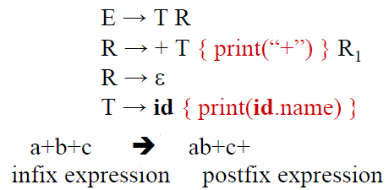
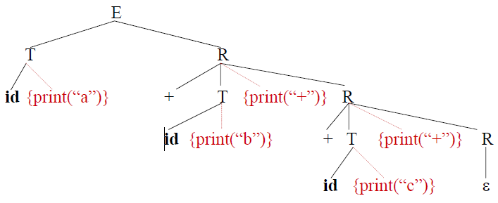
Example: Translation Scheme
Example: A simple translation schema that converts infix expression into corresponding postfix expressions.

Slide 16
THANK YOU !

